Slide 1

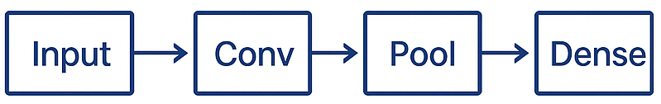
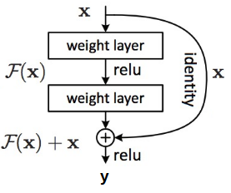
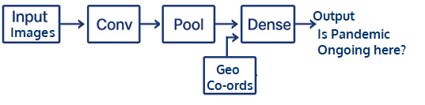
Constricting Neural Networks
Sequential, Functional, Subclassing & Custom Layers
Sequential API
.
Simple
Straight-line model
Limited Customization
X
X

Slide 2

Constricting Neural Networks
Sequential, Functional, Subclassing & Custom Layers
Advanced Model-building APIs
High
Sequential
Functional API
Model Subclass
Custom Layers
Functional API
Model Subclassing
Custom Layers
Performance
Much complex models possible
More flexibility without compromising
performance
Low
Low
High
Flexibility

Slide 3
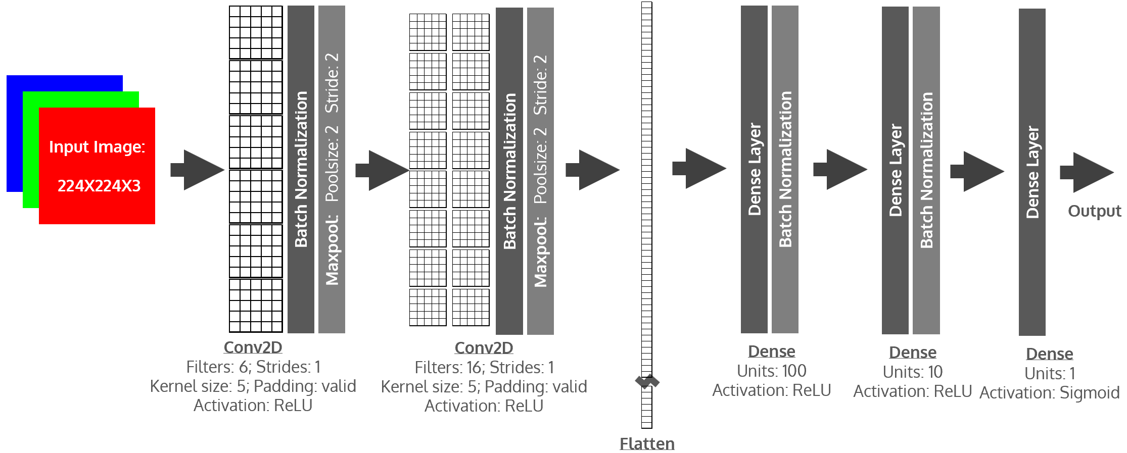
CNN LeNet Model

Slide 4
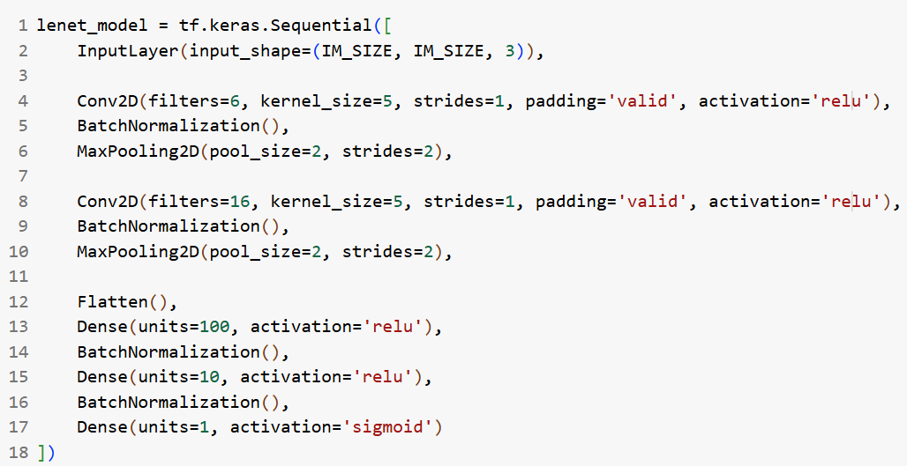
Sequential Model Creation Code

Slide 5
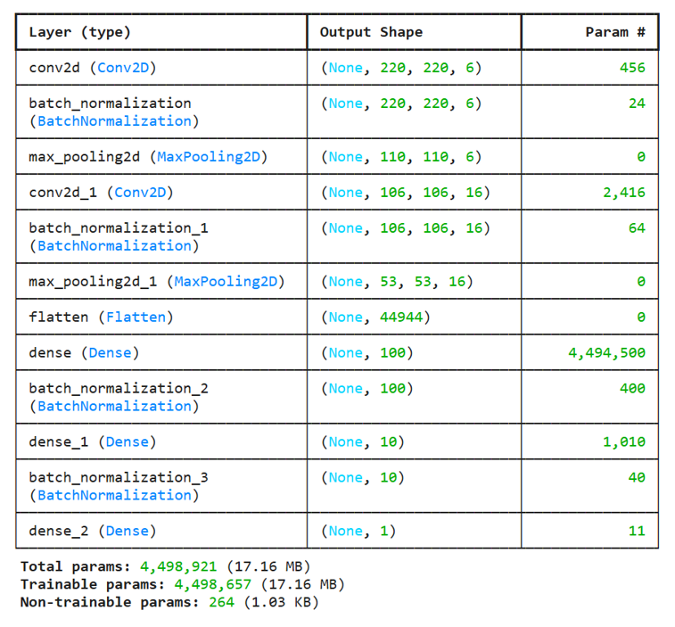
Sequential Model

Slide 6
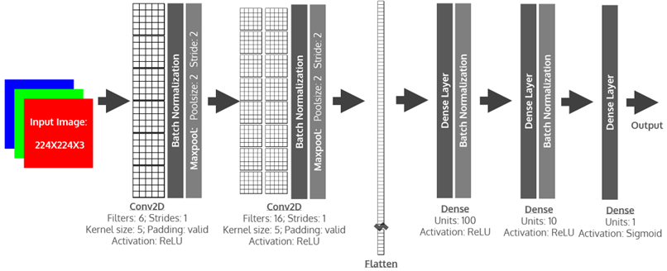
Functional Model
Each layer is created by a function call
Previous layers are passed in as the function’s parameters
Though in this example, the exact same model is created in both cases; Functional Models are flexible to create much complex architectures

Slide 7
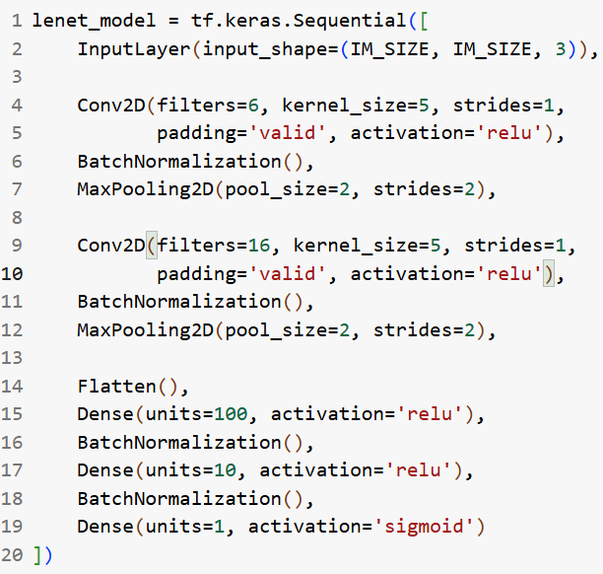
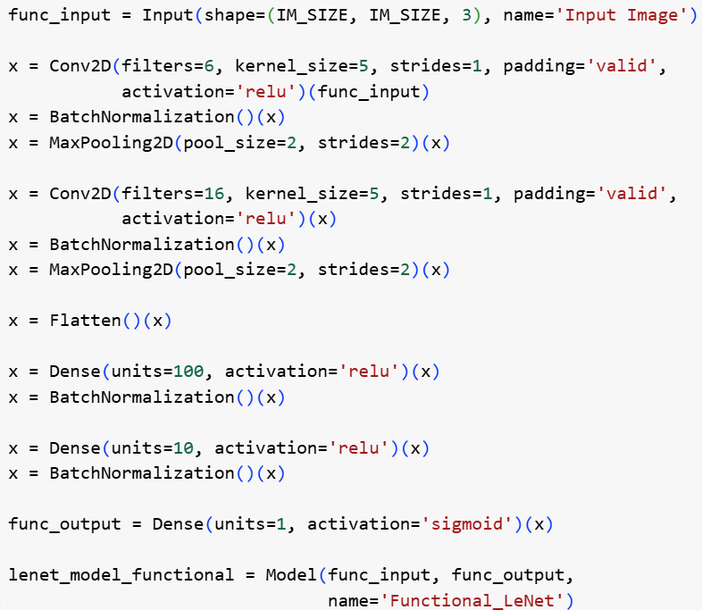
Functional Model Creation Code

Slide 8
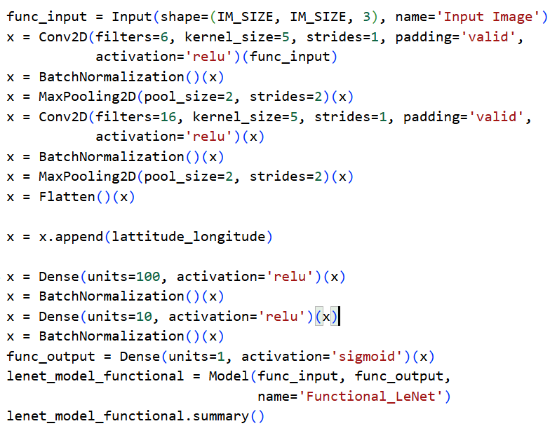
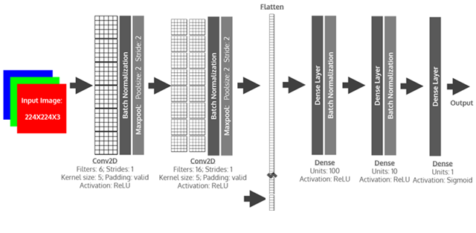


Flexible Functional Model with Geo Locations

Slide 9
Model Subclassing
Different Layers can be Encapsulated as Subclass of a Layer Object
e.g. These layers will be encapsulated
in the following slide

Slide 10
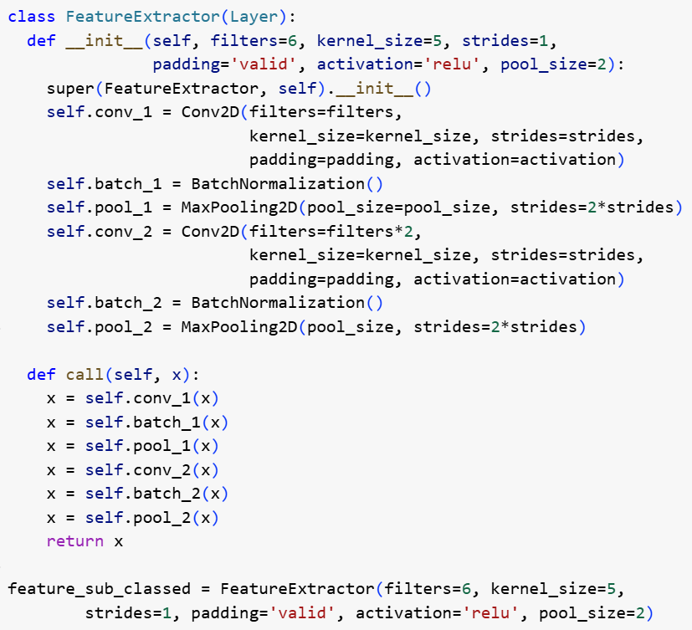
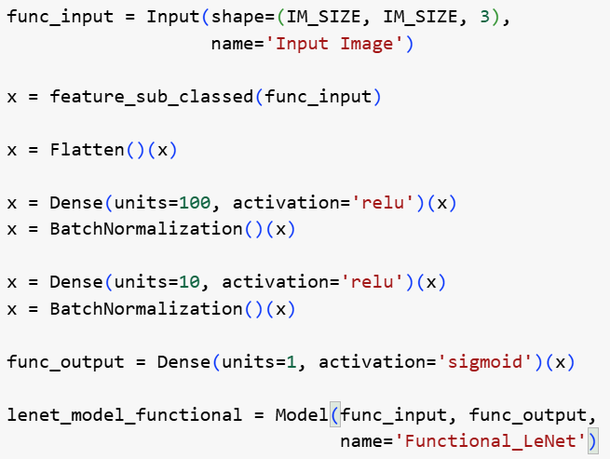
Model Subclassing Code
Model subclass is created by a function call

Slide 11
Model Subclassing
In this case, exactly the same model is created as the sequential or functional models, though much complex architectures are possible here

Slide 12
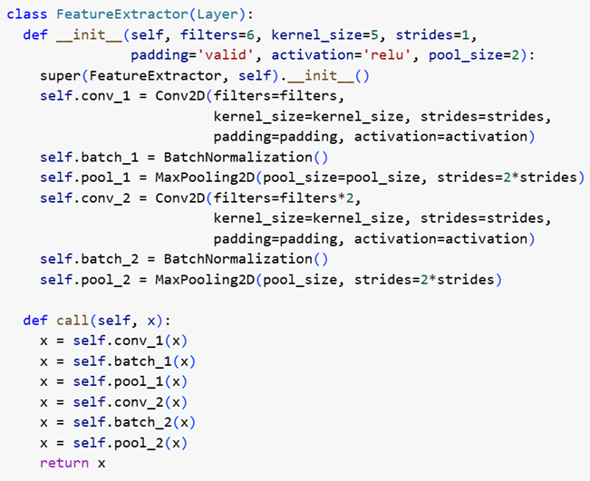
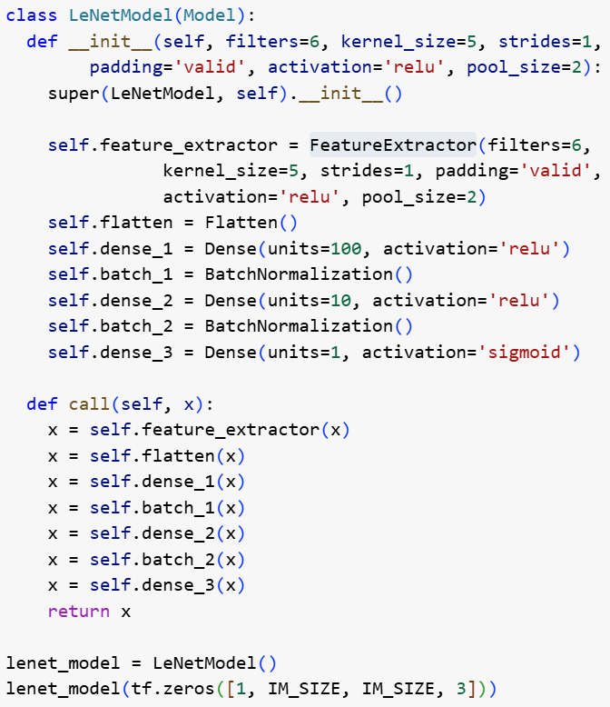
Subclassing All the Layers of the Entire Model
Entire Network is Encapsulated as a Model Object (instead of Layer object)

Slide 13
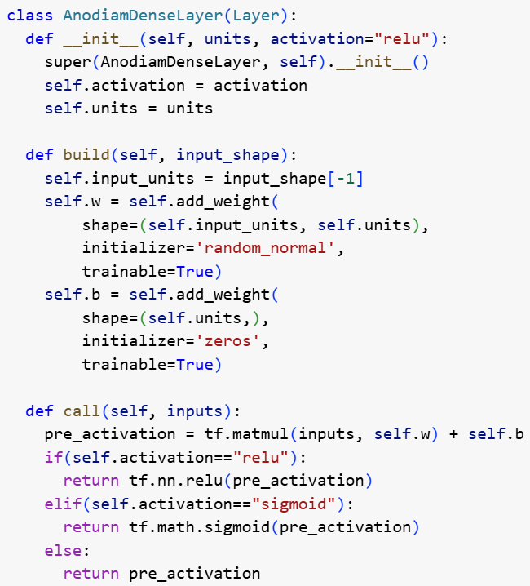
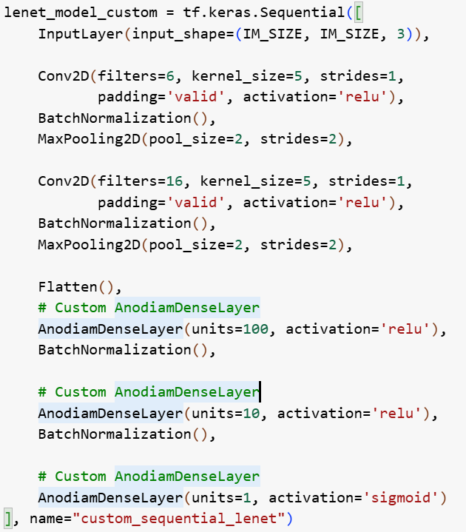
Custom Layers

